Slide 1

“Exploratory Data Analysis on Second Hand Cars”

Slide 2
About Me
Name :- Adnan Baig
Qualification :- Bachelors Of Engineering in Mechanical Engg
“I have a degree in Mechanical Engineering, But I am interested in for solving problems by processing and analyzing the data.
I'm eager to learn Data Science to achieve my career goals and I believe that merging the analytical power of data science with my engineering background will enable me to tackle complex problems more effectively.”

Slide 3
Business Problem and Use case
Problem Statement:-
In this project I am going to analyze Second Hand Cars dataset, The data is taken by Web scrapping. This data set contains information of cars and include information of brand of car registration year of cars, transmission type, fuel type, kilometers run, price of car and location of cars, analysis will be helpful to buy second hand cars based on their features and some criteria.
Objectives:-
The objective of this project is through EDA the goals are :-
To explore and analyze the data of second hand cars based on their relevant factors like, registration years, brand, transmission type, fuel type, kilometers run and prices that will help to find the vehicles based on our critera.
To find some useful insights from Analysis
And also analysis based on some criteria :
Registration year > 2015
Transmission == ‘Manual’
Fuel type == ‘Petrol’
Price < 500000

Slide 4




Tool used
Python Programming
Pandas Libraries
Numpy Libraries
Matplot lib Libraries
Sea born Libraries

Slide 5
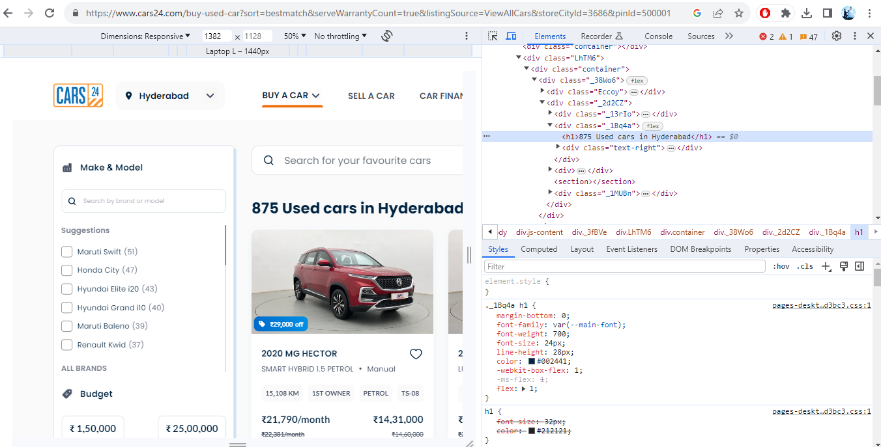
Web Scraping
Web scrapping website :- Cars24.com
Website URL:https://www.cars24.com/buy-used-car?sort=bestmatch&serveWarrantyCount=true&listingSource=ViewAllCars&storeCityId=3686&pinId=500001

Slide 6
Summary of the data
I have second hand cars data which is collected by web scrapping from cars24.com. The dataset contains
520 rows and 7 columns, lets understand the columns.
Dataset Description:-
1. Name of cars :- Name of the particular vehicle
2. Registration Year :- Manufacturing or Registration Year of Vehicle
3. Kilometer run :- Kilometers completed by vehicle
4. Transmission type :- Type of transmission vehicle having
5. Fuel type :- Type of Fuel type vehicle having
6. Price :- Price of the particular vehicle
7. Location of car :- Location of the vehicles

Slide 7
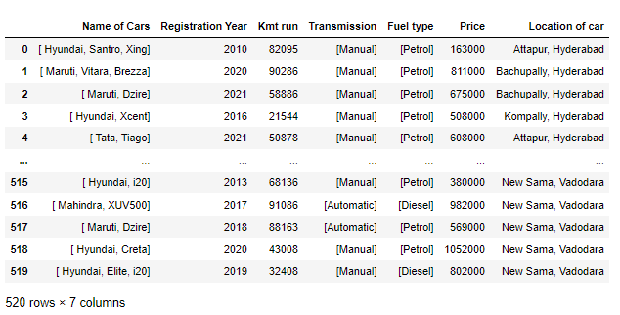
Raw data collected after web scrapping :-

Slide 8
Data Cleaning Process
1. Dataset before cleaning contains 520 rows and 7 columns.
2. Handling with structural errors using .replace(‘old’, ‘new’,inplace=True)
3. Handling with missing values by dropping rows because missing values was in Location and
Fuel type columns that’s a true data that’s why I drop that rows using df.dropna(axis=0,inplace=True)
4. Handling with duplicate data using df.drop_duplicates(inplace=True,ignore_index=True)
5. Handling with type casting using .astype(‘…..’)
6. In this dataset there in no outliers because numeric columns is Kilometers Runs, Prices, Registration year,
all are true values.
7. Handling with Incorrect Format of the data like columns sequence using new_order = [New sequence of
columns] and df = df.reindex(columns=new_order)
8. In this dataset I two more column of Name of City and Brand of vehicle which is Separate from
location and name of vehicle columns that will help in visualization.
9. After data cleaning we have 409 rows and 9 columns because I dropped duplicated and missing
values rows.

Slide 9
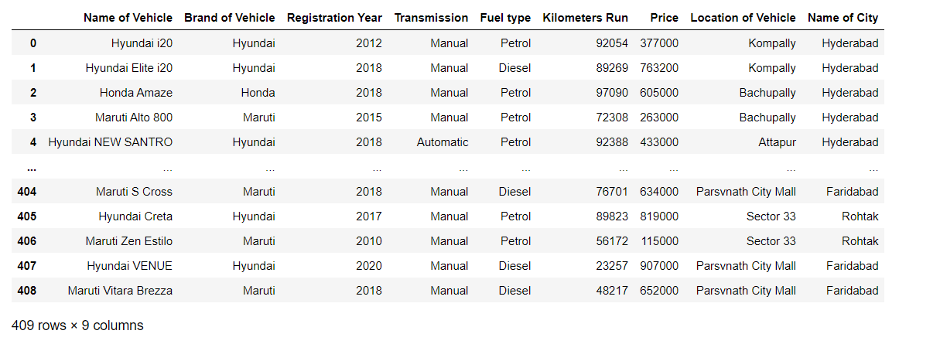
Dataset after Cleaning :-

Slide 10
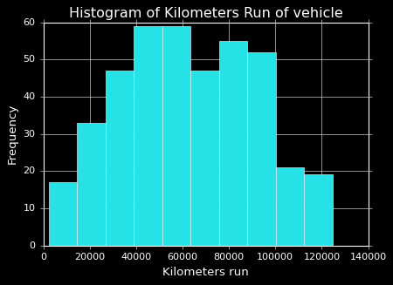
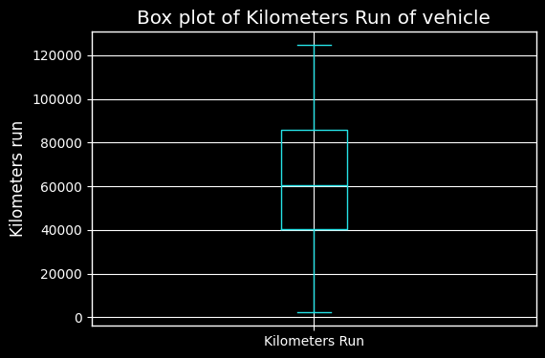
Histogram for kilometers completed
Box Plot for kilometers completed
Insights :-
* From the above plot i can see that most of the vehicles having Kilometers completed from 40000 to 60000 km.
* From a above Box plot we can see there is no outliers in data.
* And the distance between both whisker is similar and median in middle of box so we can say the data is normally distributed.

Slide 11
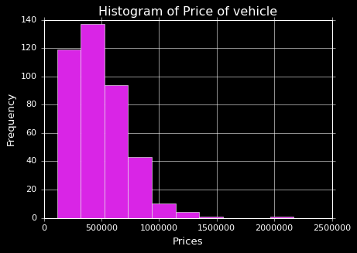
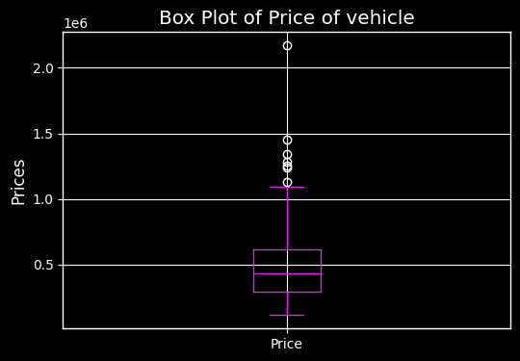
Histogram for Price of vehicles
Box Plot for Price of vehicles
Insights :-
* From above plot we can see there is most of vehicles prices under 500000 (5 lakhs) rupees.
* From a above Box plot we can see there is outliers in data of prices But it will not affect to my analysis because prices is true values.

Slide 12
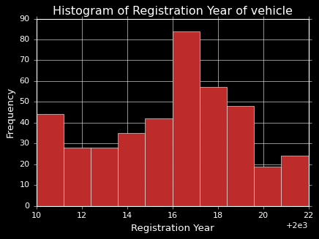
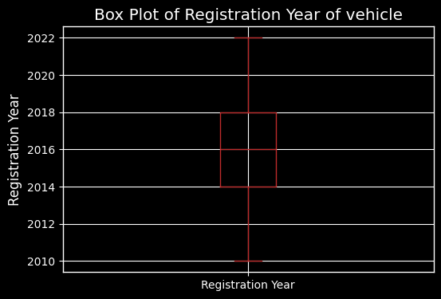
Histogram for Registration year of vehicles
Box Plot for Registration year of vehicles
Insights:-
* From the above plot we can see that most of the vehicles from 2017 year of Registration near about 90 vehicle
* From a above Box plot we can see there is no outliers in data
* And the distance between both whisker is similar and median is in middle of box so we can say the data is normally
distributed

Slide 13
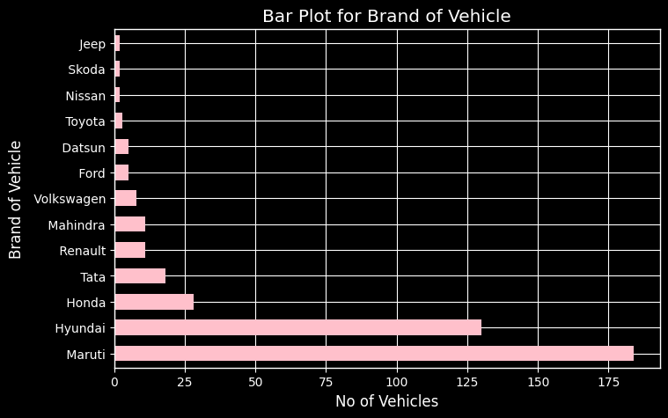
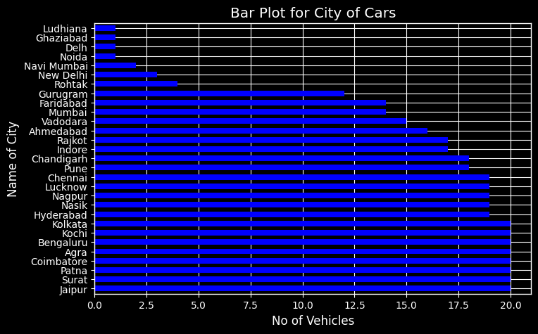
Bar plot for Brand of vehicles
Bar plot for City of vehicles
Insights :-
* From the first bar plot we can see there is more vehicles from Maruti Brand more than 175 count.
* From the second bar plot we can see there is more vehicles in cities Like Patna, Kolkata, Jaipur, Agra, Chennai, Bengaluru,
Coimbatore, Surat and Kochi.

Slide 14
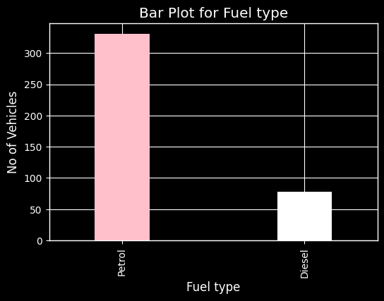
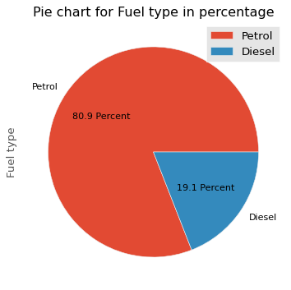
Bar plot for fuel type of vehicles
Pie chart to check the percentage
Insights :-
* From the above plot we can see there is most of the vehicles having Fuel type of Petrol near about 330 vehicles.
* And less vehicles having fuel type of Diesel near about 80 vehicles.
* There is 80.9 percent of vehicles having Petrol Fuel type, and there is 19.1 percent of vehicles having Diesel Fuel type.

Slide 15
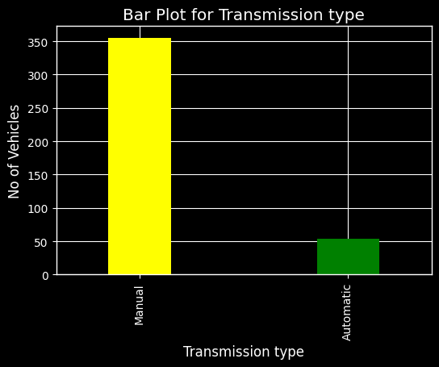
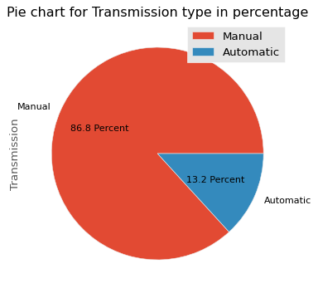
Bar plot for Transmission type of vehicles
Pie chart to check percentage
Insights :-
* From the above plot we can see there is most of the vehicles having Transmission type of Manual near about 360 vehicles.
* And less vehicles having Transmission type of Automatic near about 50 vehicles.
* There is 86.8 percent of vehicles having Manual Transmission and there is 13.2 percent of vehicles having Automatic
Transmission.

Slide 16
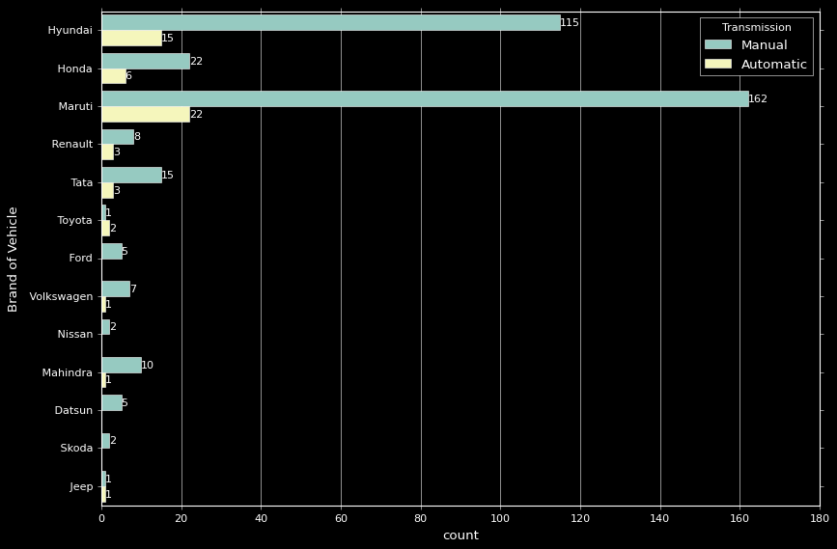
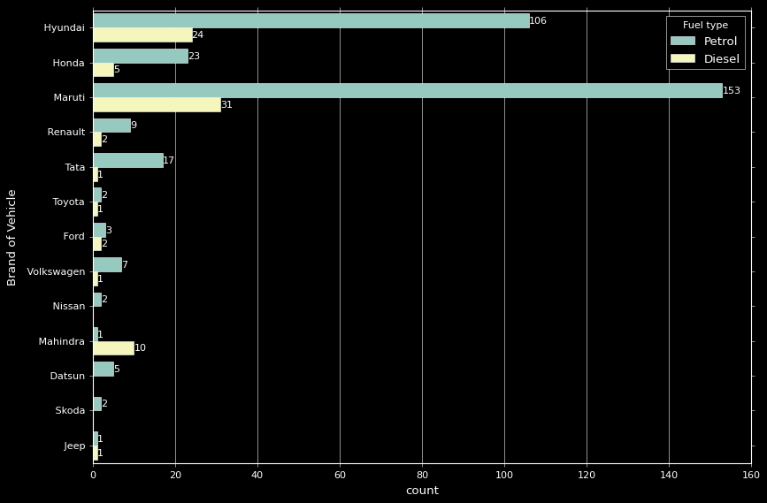
Count plot between Brand and Transmission of vehicles
Count plot between Brand and Fuel type of vehicles
Insights :-
* From above plot we can see highest vehicles coming from Maruti which is having Manual transmission near about 162 count.
* second highest vehicle coming from Hyundai which is having Manual transmission near about 115 count.
* From another plot we can see highest vehicles coming from Maruti which is running on petrol near about 153 count.
* second highest vehicle coming from Hyundai which is running on petrol near about 106 count.

Slide 17
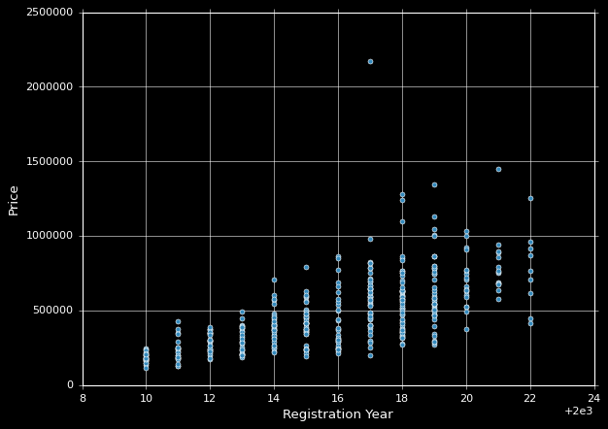
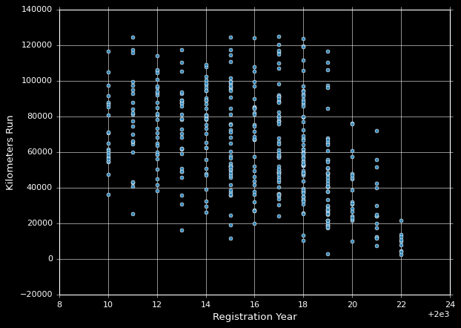
Scatter plot between Price and Registration Year
Scatter plot between Kilometers and Registration Year
Insights :-
* In the first Scatter plot the direction is positive because there is increment order if the year of registration increasing so price
also increasing.
* And we can see strength is strong because scatter is little close to each other.
* In the second Scatter plot the direction is Negative because there is decrement order if the Kilometers run decreasimg so
registration year is decreasing.
* And we can see strength is weak because scatter is not close to each other.

Slide 18
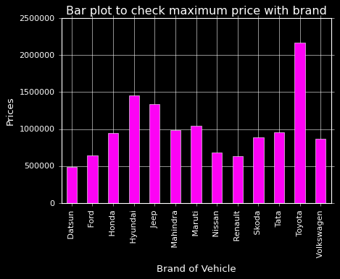
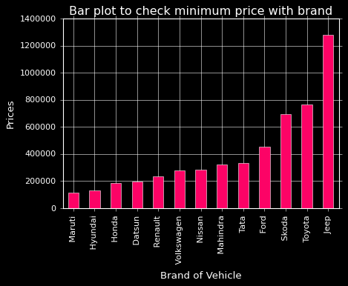
Bar plot to check maximum prices
Bar plot to check minimum prices
Insights :-
* From first data we can see maximum prices of cars based on their brand.
* Toyota brand having the maximum prices cars.
* From second data we can see minimum prices of cars based on their brand.
* Maruti brand having the minimum prices cars.

Slide 19
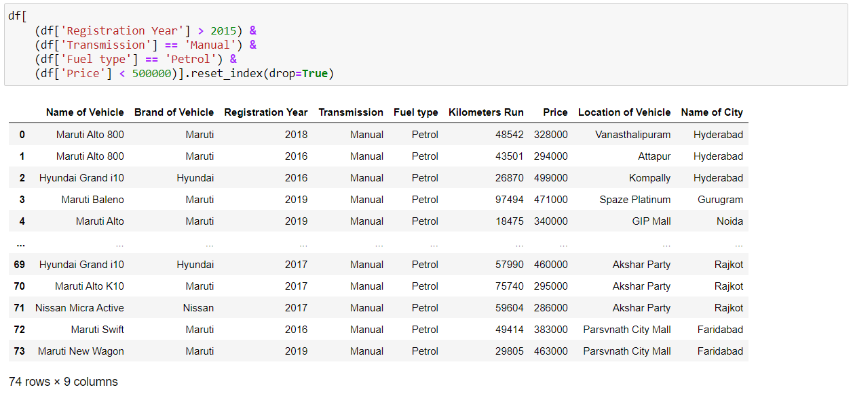
Analysis based on some criteria
Insights :-
* From above data frame we can conclude we have 74 vehicles having Registration year greater than 2015 and
Transmission is Manual, Fuel type is Petrol, Price is less than 500000 rupees .

Slide 20
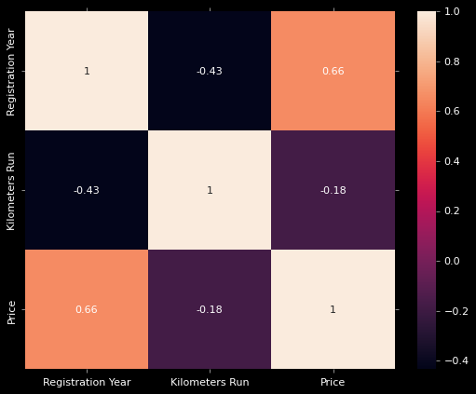
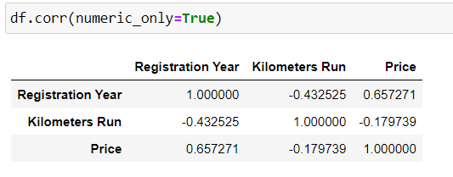
Heat map
Insights :-
* Ranges -0.4 to +0.0 representing Negative weak correlation which is shown by dark color.
* Ranges +0.0 to +0.8 representing positive moderate correlation which is shown by light color.
* Ranges +0.8 to +1.0 representing Positive strong correlation which is shown by light color.
* Registration year and price having the positive moderate correlataion .

Slide 21
Conclusion
1. From the above analysis I can conclude that the most of the vehicles are having registration year of 2017.
2. Fuel type is petrol.
3. Transmission type is manual.
4. Kilometers completed between 40000 to 60000.
5. Prices lies under 500000.
6. These vehicles are from Maruti and Hyundai brand,.
7. In cities Like Patna, Kolkata, Jaipur, Agra, Chennai, Bengaluru, Coimbatore, Surat and Kochi.
8. We can conclude we have 74 vehicles having Registration year greater than 2015 and
Transmission is Manual, Fuel type is Petrol, Price is less than 500000 rupees .

Slide 22

THANK YOU

